Slide 1
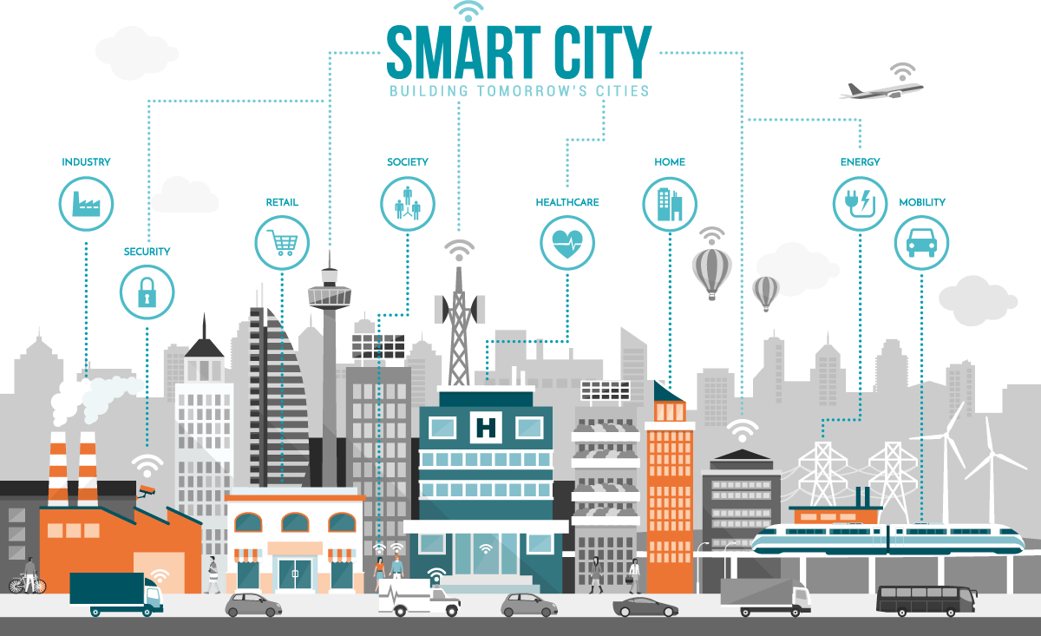
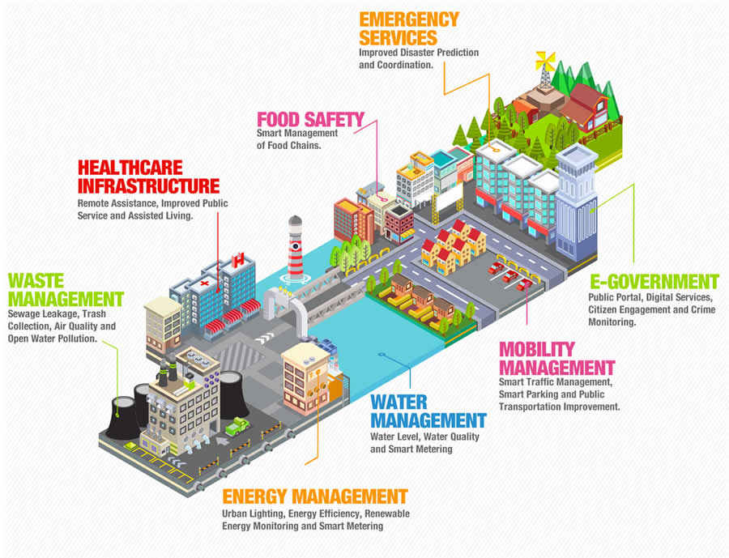
Smart Cities: Paris Model
Ediz Emektas
Esteban Echeverry
Lawrence kaara Mburia
Rawad Bassil

Slide 2
CONTEXT
🗺
GLOBAL CONTEXT
INTERNAL PROBLEMS
No good infrastructure to handle major crises
Bad Waste, Energy & Water Management
Poor air quality, very polluted areas
Heavy Traffic and Congestions
The world is becoming massively urbanized
Global cities are becoming increasingly
A digital transformation is taking over the world
Major Climate & Environmental consequences
Paris must strive to become more connected, sustainable, attractive & inclusive
PARIS

Slide 3
Smart City Model Implementation
3
1
2
4
Implement Eco-Friendly Approaches
Utilize IoT Devices throughout Paris
Paris is becoming smarter and carving its own path
Instant feedback to responsible personnel leading to quick, constant and efficient responses to mitigate problems
Improve services and quality
Improve Infrastructure

Slide 4
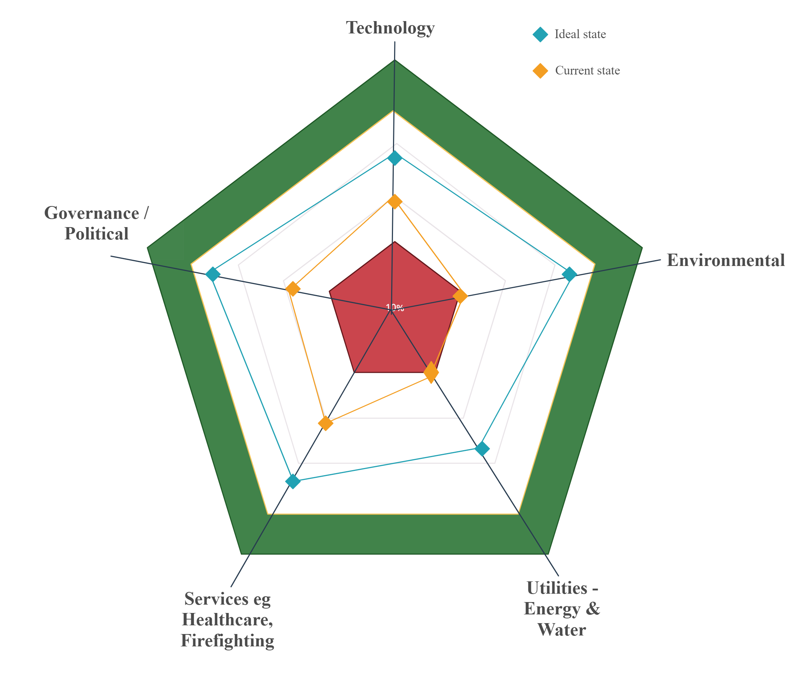
Gap Analysis

Slide 5
Challenges
Lack of Funds and Technology
Governance
Connectivity
Not enough coverage to support smart city applications
project could be more than unachievable
This will allow services to be joined up and ongoing improvements to be made as demand increases.
02
Implementation involves a long series of legislative and policy agreements
Added layer due to private or associative actors collaborating to finance projects
Each city has a different culture and operation, so it is necessary to adapt.
→ Not always possible to rely on other proven smart city projects to act as a model for the success of others.
01
Lack of Infrastructure & Labor
Privacy and Security Risks
Urban infrastructure plays a crucial role in Smart City projects
Depending on the existing infrastructure in i.e., energy, water and transportation systems, a project may be formulated requiring investment time
Skilled labor is needed to transform urban infrastructure into Smart infrastructure → requires more time and investment.
Availability
Integrity
Confidentiality
Accountability
04
03

Slide 6
Waste Management
Dog Waste Management Case Study
Dog waste management has become an increasing concern in the Paris city. Almost on any street, you are likely to find abandoned dog waste by owners thus increasing cleanliness costs and becomes a source of untidiness.
Parisians and other city dwellers as seen by statistics are preferring pets. This increase should be coupled with civic responsibility by owners including waste management
Remediations
How can this be managed better ?
Education
Taxation
Introduction of waste bins
→ Involve the local municipal authorities, owners, business community, etc.
➔ The reason behind this is to ensure a safe and clean environment
Nature of knowledge: Incremental
How to measure effectiveness:
By checking street cleanliness
Context

Slide 7
Essential Technologies
Artificial Intelligence
Internet of Things (IoT)
AI measurement and monitoring will be the big players in the IoT market for smart cities
Preventive maintenance is one of the main functions of this technology and one of the most important benefits
Traffic management and improving the safety of citizens on the roads is another function of AI in smart cities.
AI-powered security cameras are being used that go beyond video surveillance functions
Collect data through sensors
Connected devices and intelligent networks to analyze the data
Obtain valuable information to improve urban services, sustainability, safety, mobility and transparency of the city
➔ IoT is acting in the cities, mainly, in three areas: transport and urban mobility, energy and urban maintenance.
Blockchain
Geospatial Technology
Technology that would allow cities to overcome challenge such as: participation, transparency, sustainability, competitiveness, corruption and fraud.
Fast growing technology and trend: the value of this technology will exceed 16B EUR in 2024 globally
With Blockchain → provide a neutral, accessible and secure information base to prevent corruption and establish the necessary transparency in public administration
Makes urban environments more accessible and environmentally friendly
Detects disasters that affect the ecosystem
Reacts to citizens’ demand by offering solutions in transport, power plants, water supply networks, civil protection or public centers, etc.
Easier for public administrations to make better decisions in the environmental management of their cities

Slide 8
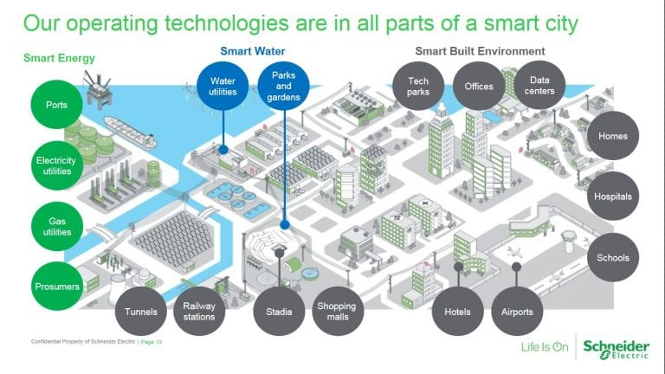
Conclusion
Apparent Beneficial Outcomes
Processes are fast, automated and everything is connected and accessible
Better resources and services management and operability
Move towards eco-friendliness
Reducing congestions, traffic and improving transportation
Underlying Consequences to be Considered
Major privacy and Security Risks
Lots of new technologies and systems are to be implemented all over the city
Shift towards eco-friendliness… by wasting more material and using more energy sources ?
The intent to be PROACTIVE instead of REACTIVE ➔ Disaster Management is essential

